Slide 1



Sales & Financial Dashboard Transforming Data into Business Decisions
By : Rithikkaa S J
This Photo by Unknown Author is licensed under CC BY-SA

Slide 2

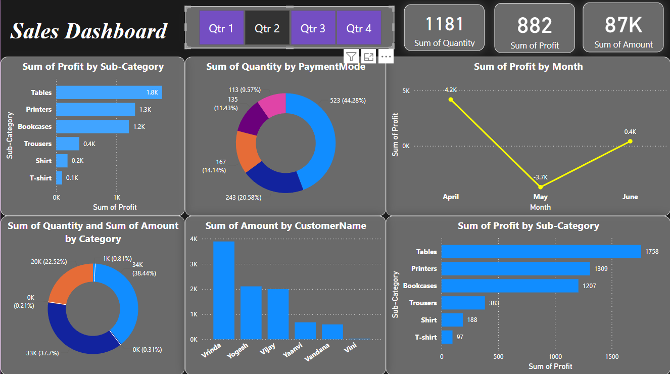
Purpose of the Dashboard
Why this Dashboard?
To provide a visual, interactive summary of sales and financial performance
Help stakeholders identify trends, outliers and top performers
Facilitate quick, data-driven decision-making

Slide 3
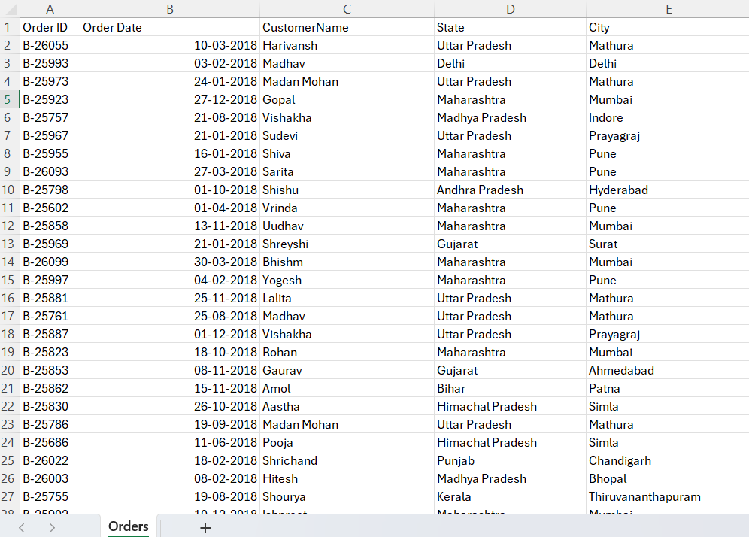
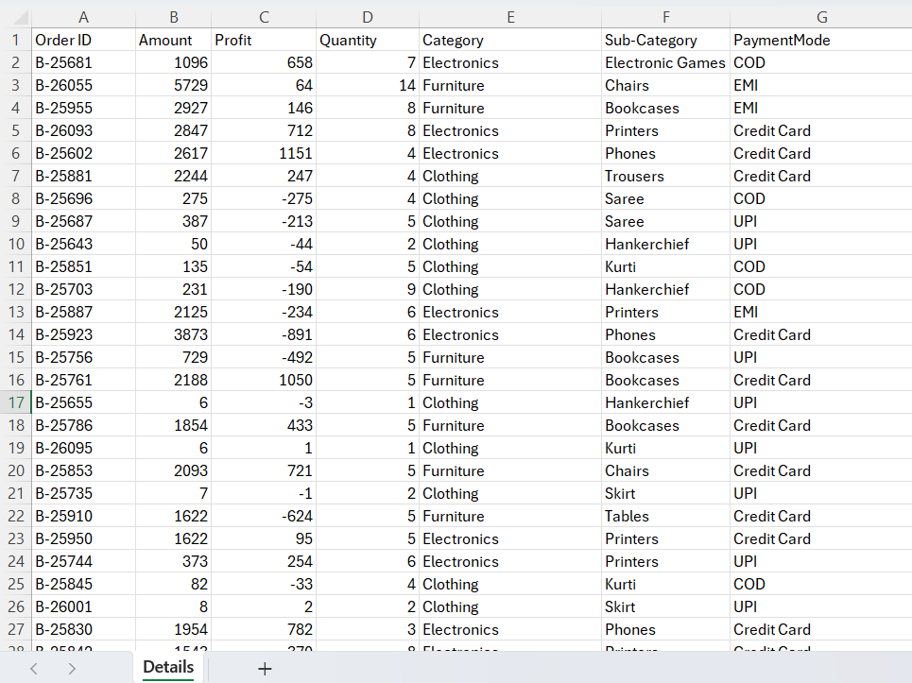
Data Sources
Primary Datasets Used:
Orders.csv
Order ID, Category, Sub-Category, Quantity, Amount, Profit, Payment Mode, Date
Details.csv
Product Name, Customer Name, Region
Purpose: Combined to create a comprehensive view of sales transactions and customer behaviour.

Slide 4
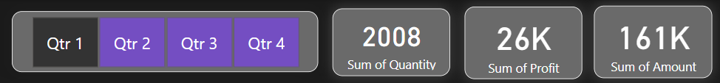
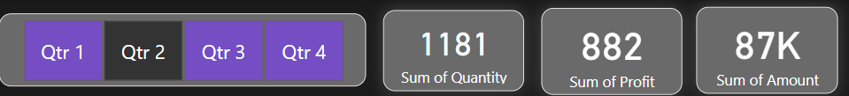
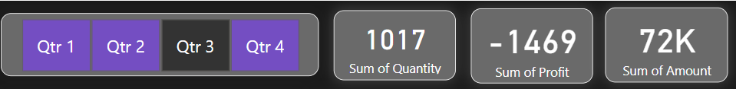
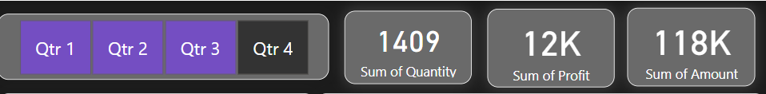
Key Metrics (KPIs) Tracked
Main Business KPIs Visualized:
💰 Total Sales Revenue
📦 Total Quantity Sold
📈 Total Profit
🛒 Top Performing Products & Categories
🙋 Top Customers by Revenue
⏱️ Monthly Profit Trends
💳 Preferred Payment Methods

Slide 5
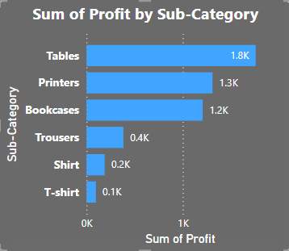
Profitable Product Sub-Categories
Top Performing Sub-Categories (by Profit) for QTR 2 :
Tables – ₹1.8K
Printers – ₹1.3K
Bookcases – ₹1.2K
Business Insight:
Focus on high-profit segments for promotions, bundling and inventory optimization

Slide 6
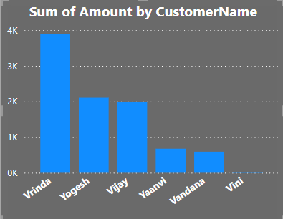
Customer Insights
Highest-Spending Customers:
Vrinda
Yogesh
Vijay
Yaavni
Business Insight:
Launch customer loyalty programs
Prioritize personalized outreach to top revenue drivers

Slide 7
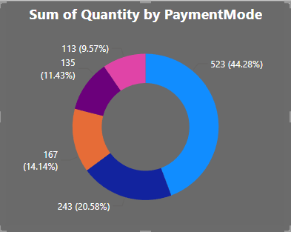
Payment Mode Analysis
Most Common Payment Methods:
Card – 44.28%
UPI – 20.58%
Cash/Wallet/Net Banking – Less used
Business Insight:
Customers prefer convenient digital payments
Encourage use of popular modes through cashback or fast checkout

Slide 8
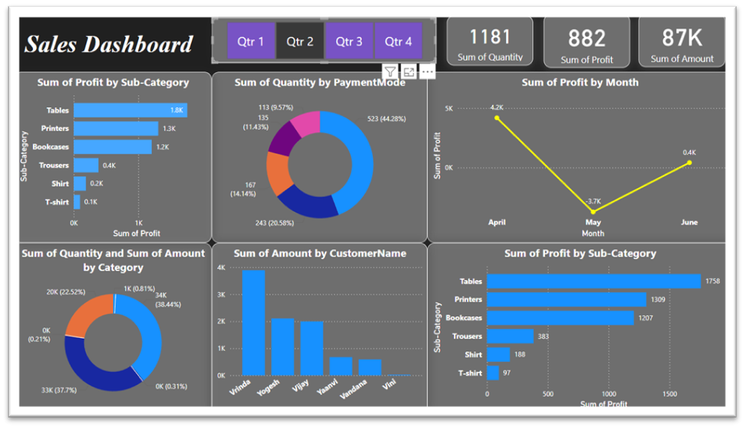
Dashboard Interactivity & Design
User-Centric Features:
🔎 Slicers for Category, Payment Mode, Time Period
🎯 Drill-downs to sub-category or product level
📋 Summary Cards for quick KPIs
🎨 Consistent color scheme and intuitive layout
Purpose: Designed to let business users explore data independently with minimal training

Slide 9

Final Business Takeaways
1. Tables, Printers and Bookcases are the most profitable 2. April showed a major profit dip – investigate operational issues 3. Vrinda and Yogesh are key customers 4. Card and UPI dominate payment preferences
Outcome: Stakeholders gain a clear, action-ready understanding of business performance

